Slide 1
Introduction to Wireless Sensor Networks

Slide 2
Table of References
Slides | Source
6 | www.cse.fau.edu/~jie/teaching/fall_2004_files/sensorslides1.ppt
19-23 | http://web2.uwindsor.ca/courses/cs/aggarwal/cs60520/SeminarMaterial/WSN-future.ppt
7-13 | http://web.cecs.pdx.edu/~nbulusu/talks/grace-hopper.ppt
17-18,29-33 | http://galaxy.cs.lamar.edu/~bsun/wsn/wsn.html
15-16 | www.dsc.ufcg.edu.br/~maspohn/katia/introduction.ppt
24 | http://computer.howstuffworks.com/mote1.htm
32-33 | http://www.polastre.com/papers/polastre-thesis-final.pdf

Slide 3
Agenda
Introduction
Differences with ad hoc networks
Applications
Characteristics
Challenges
Future
Motes
Hardware Setup Overview

Slide 4
Introduction
Wireless Sensor Networks are networks that consists of sensors which are distributed in an ad hoc manner.
These sensors work with each other to sense some physical phenomenon and then the information gathered is processed to get relevant results.
Wireless sensor networks consists of protocols and algorithms with self-organizing capabilities.

Slide 5
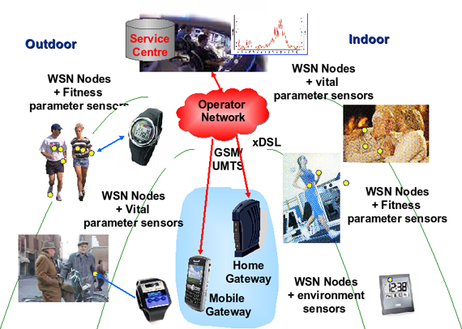
Example of WSN
Ref:http://esd.sci.univr.it/images/wsn-example.png

Slide 6
Comparison with ad hoc networks
Wireless sensor networks mainly use broadcast communication while ad hoc networks use point-to-point communication.
Unlike ad hoc networks wireless sensor networks are limited by sensors limited power, energy and computational capability.
Sensor nodes may not have global ID because of the large amount of overhead and large number of sensors.

Slide 7
Applications of Wireless Sensor networks
The applications can be divided in three categories:
Monitoring of objects.
Monitoring of an area.
Monitoring of both area and objects.

Slide 8
Monitoring Area
Environmental and Habitat Monitoring
Precision Agriculture
Indoor Climate Control
Military Surveillance
Treaty Verification
Intelligent Alarms

Slide 9
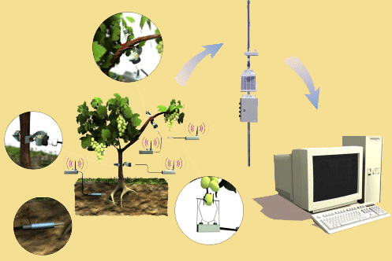
Example: Precision Agriculture
Precision agriculture aims at making cultural operations more efficient, while reducing environmental impact.
The information collected from sensors is used to evaluate optimum sowing density, estimate fertilizers and other inputs needs, and to more accurately predict crop yields.
Notes:
Ref-http://www.agrisupportonline.com/phy/index.htm

Slide 10
Monitoring Objects
Structural Monitoring
Eco-physiology
Condition-based Maintenance
Medical Diagnostics
Urban terrain mapping

Slide 11
Example: Condition-based Maintenance
Intel fabrication plants
Sensors collect vibration data, monitor wear and tear; report data in real-time
Reduces need for a team of engineers; cutting costs by several orders of magnitude

Slide 12
Monitoring Interactions between Objects and Space
Wildlife Habitats
Disaster Management
Emergency Response
Ubiquitous Computing
Asset Tracking
Health Care
Manufacturing Process Flows

Slide 13
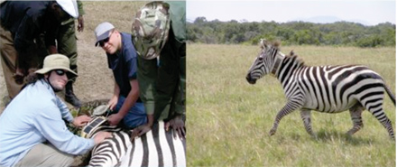
Example: Habitat Monitoring
The ZebraNet Project
Collar-mounted sensors monitor zebra movement in Kenya
Source: Margaret Martonosi, Princeton University

Slide 14
Characteristics of Wireless Sensor Networks
Wireless Sensor Networks mainly consists of sensors. Sensors are -
low power
limited memory
energy constrained due to their small size.
Wireless networks can also be deployed in extreme environmental conditions and may be prone to enemy attacks.
Although deployed in an ad hoc manner they need to be self organized and self healing and can face constant reconfiguration.

Slide 15
Design Challenges
Heterogeneity
The devices deployed maybe of various types and need to collaborate with each other.
Distributed Processing
The algorithms need to be centralized as the processing is carried out on different nodes.
Low Bandwidth Communication
The data should be transferred efficiently between sensors

Slide 16
Continued..
Large Scale Coordination
The sensors need to coordinate with each other to produce required results.
Utilization of Sensors
The sensors should be utilized in a ways that produce the maximum performance and use less energy.
Real Time Computation
The computation should be done quickly as new data is always being generated.

Slide 17
Operational Challenges of Wireless Sensor Networks
Energy Efficiency
Limited storage and computation
Low bandwidth and high error rates
Errors are common
Wireless communication
Noisy measurements
Node failure are expected
Scalability to a large number of sensor nodes
Survivability in harsh environments
Experiments are time- and space-intensive

Slide 18
Enabling Technologies
Embed numerous distributed devices to monitor and interact with physical world
Network devices to coordinate and perform higher-level tasks
Embedded
Networked
Control system w/
Small form factor
Untethered nodes
Exploit collaborative
Sensing, action
Sensing
Tightly coupled to physical world
Exploit spatially and temporally dense, in situ, sensing and actuation

Slide 19
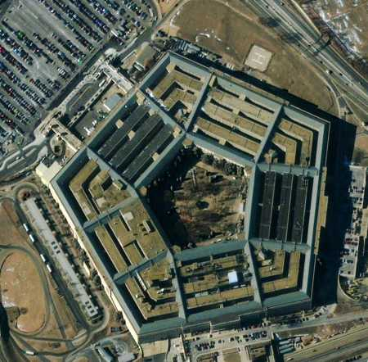
Future of WSN Smart Home / Smart Office
Sensors controlling appliances and electrical devices in the house.
Better lighting and heating in office buildings.
The Pentagon building has used sensors extensively.

Slide 20
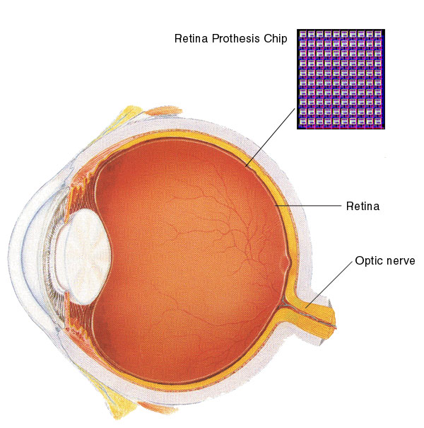
Biomedical / Medical
Health Monitors
Glucose
Heart rate
Cancer detection
Chronic Diseases
Artificial retina
Cochlear implants
Hospital Sensors
Monitor vital signs
Record anomalies

Slide 21

Military
Remote deployment of sensors for tactical monitoring of enemy troop movements.

Slide 22
Industrial & Commercial
Numerous industrial and commercial applications:
Agricultural Crop Conditions
Inventory Tracking
In-Process Parts Tracking
Automated Problem Reporting
RFID – Theft Deterrent and Customer Tracing
Plant Equipment Maintenance Monitoring

Slide 23
Traffic Management & Monitoring
Future cars could use wireless sensors to:
Handle Accidents
Handle Thefts
Sensors embedded in the roads to:
Monitor traffic flows
Provide real-time route updates

Slide 24
What are motes?
Motes mainly consist of three parts:-
Mote basically consists of a low cost and power computer.
The computer monitors one or more sensors. Sensors may be for temperature, light, sound, position, acceleration, vibration, stress, weight, pressure, humidity, etc.
The computer connects to the outside world with a radio link.

Slide 25
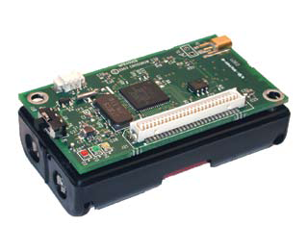
Mica 2 Motes
These motes sold by Crossbow were originally developed at the University of California Berkeley.
The MICA2 motes are based on the ATmega128L AVR microprocessor. The motes run using TinyOS as the operating system.
Mica2 mote is one of the most popular and commercially available sensors which are marketed by CrossBow technologies.
MICA 2 MOTE
Ref:http://www.xbow.com/Products/Product_pdf_files/Wireless_pdf/MICA2_Datasheet.pdf

Slide 26
Telosb Motes
Telosb motes have USB programming capability
An IEEE 802.15.4 compliant, high data rate radio with integrated antenna, a low-power MCU
There are also equipped with extended memory and an optional sensor suite

Slide 27
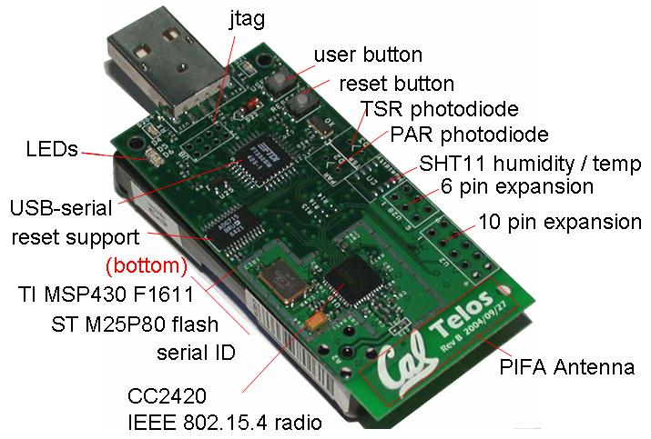
TELOSB MOTE
Ref:http://www.eecs.berkeley.edu/~culler/eecs194/labs/lab1/telosb.JPG

Slide 28
One Example Sensor Board - MTS310

Slide 29
One More Example of Sensor Board - MTS400/420
Besides the functions of MTS 300, it mainly adds GPS functionality
Further Reading
http://firebug.sourceforge.net/gps_tests.htm

Slide 30
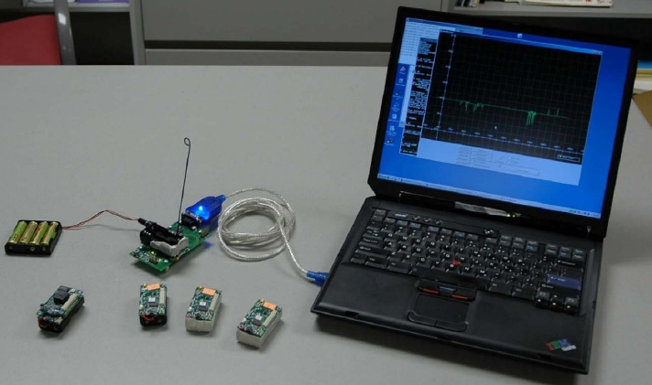
Hardware Setup Overview

Slide 31
Programming Board (MIB520)

Slide 32
One Proposed WSN Functional Layer Decomposition
Ref: Fig. 1.1 of J. Polastre Dissertation

Slide 33
Architecture to Build WSN Applications
Ref: Fig. 2.1 of J. Polastre Dissertation

Slide 34
References
Eschenauer, L., and V. Gligor, “A Key-Management Scheme for Distributed Sensor Networks,” Proceedings of ACM Conference on Computer and Communications Security (ACM CCS), Washington DC, pp. 41-47, 2002
http://www.xbow.com/products/Product_pdf_files/Wireless_pdf/MICA2_Datasheet.pdf
http://www.ece.osu.edu/~bibyk/ee582/telosMote.pdf
http://en.wikipedia.org/wiki/Wireless_Sensor_Networks
http://arri.uta.edu/acs/networks/WirelessSensorNetChap04.pdf
http://www.eecs.harvard.edu/~mdw/course/cs263/papers/jhill-thesis.pdf
http://www.polastre.com/papers/polastre-thesis-final.pdf
www.cse.fau.edu/~jie/teaching/fall_2004_files/sensorslides1.ppt
http://web2.uwindsor.ca/courses/cs/aggarwal/cs60520/SeminarMaterial/WSN-future.ppt
http://web.cecs.pdx.edu/~nbulusu/talks/grace-hopper.ppt
http://galaxy.cs.lamar.edu/~bsun/wsn/wsn.html
www.dsc.ufcg.edu.br/~maspohn/katia/introduction.ppt
http://computer.howstuffworks.com/mote1.htm

